Slide 1



CREDIT PORTFOLIO ANALYSIS
Presented by : Arsalan Aftab
CAPSTONE # 03

Slide 2
EXAMING THE PORTFOLIO
Portfolio contains the following attributes :
Age of Customers: The age of customers is varied in the portfolio from 19 to 75.
Gender: It is defined in our portfolio that the consumer is male or female.
Job : The consumers are segregated into four attributes on the basis of job i.e Highly Skilled, Skilled, Un-skilled and Non Resident, Un-Skilled and Resident.
Housing: The nature of shelter they possess i.e Owned, Rental, Free
Saving Accounts: No saving account, little, rich, quite rich. These accounts are usually used by housewife, young adults for saving, and for getting monthly profit.
Checking Accounts: Used by business owners, and have high volume of transactions daily, weekly, fortnightly or monthly.
Credit Amount : The amount credit to consumer for their requirement.
Duration : Number of months in which credited amount to be repaid.
Purpose: Loans are provided to consumers for radio/TV , education, furniture/equipment, car, business domestic, appliances repairs, vacation/others
Risk : Assigned to the customer on the basis of past relation with the bank & credit score card rating (all cliental details) and repayment of dues (Good or Bad)

Slide 3
EVALUATING
Count GOOD AND BAD rated customers in our portfolio.
Amount Credited to Good & Bad Rated Customers.
Amount Credited to different age groups.
Segregation of Good & Bad rated customers on the basis of age brackets.
Determining the amount of Credits given to different Job holders with different skill set
Determining the duration of loans along with GOOD & BAD in the portfolio
Analyzing the terms of Loans given to customers so that we can determine the return period on loans
Finding the purpose of Loan for different products
Purpose of Loans on the basis of Gender.
Finding the Correlation of the different variables.
Checking & Saving Account holders exposure to Credits.
Discussing the Key Findings

Slide 4
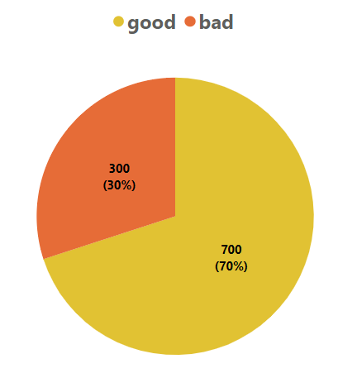
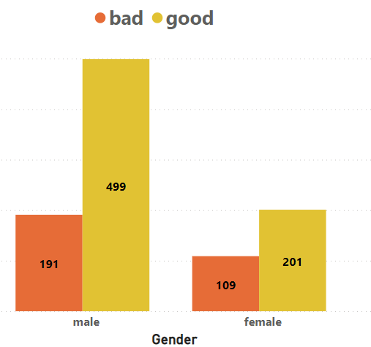
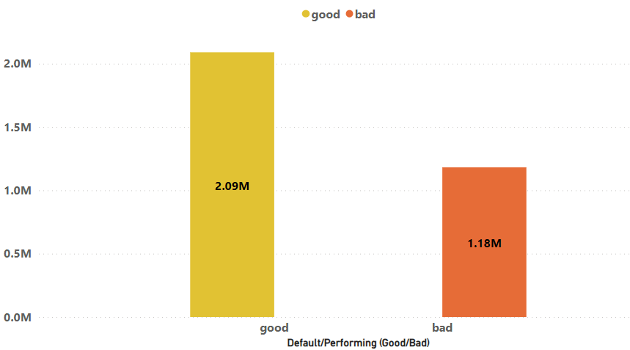
COUNT OF GOOD AND BAD CREDITS IN PORTFOLIO
According to Risk rating 700 customers in portfolio are rated as good in category while 300 customers are rated as bad.
Most of the male clients are performing clients and have good Risk rating.

Slide 5
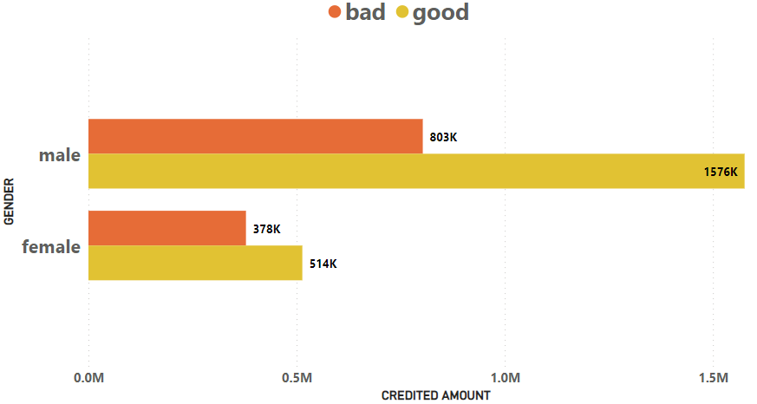
AMOUNT CREDITED TO GOOD AND BAD RATED CUSTOMER
Among 300 bad rated customers we have 191 males that makes up to 63.6% of bad, where as in 700 Good rated customers we have 499 males that makes up to 71.28%. So there is high risk of default but at the same there is high value of returns.
Male Amount Total = 2,379,148
Female Amount Total = 892,110
Among 300 bad rated customers we have 109 females that makes up to 36.4% of bad, where as in 700 Good rated customers we have 201 females that makes up to 28.72%. So there is less risk of default but at the same there is low value of returns.

Slide 6
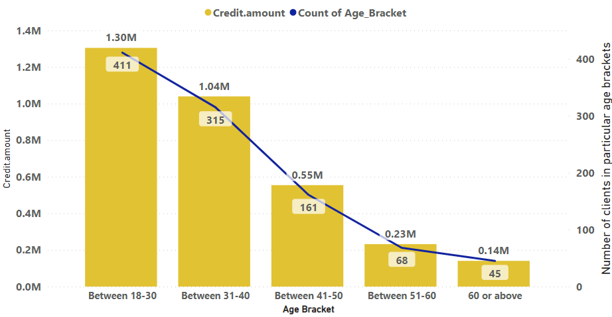
CREDIT AMOUNT TAKEN BY DIFFERENT AGE GROUPS
About 72.6% of the entire portfolio is based on the aged between 18-40

Slide 7
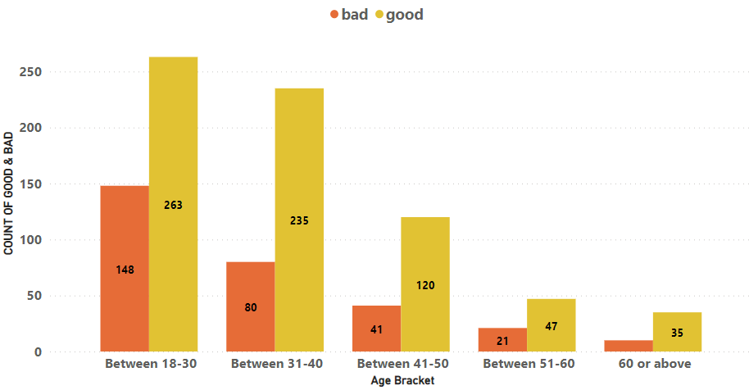
SEGREGATION OF GOOD & BAD AGE WISE
726 out of 1000 clients (72.6%) are aged between 18-40 out of which 498 are Good rated which means 68.6% clients are reliable for credit, for further investigation we have to check the skill and job of the consumers also the age bracket of 41-50 can be considered for stable credits but with short term loans.

Slide 8
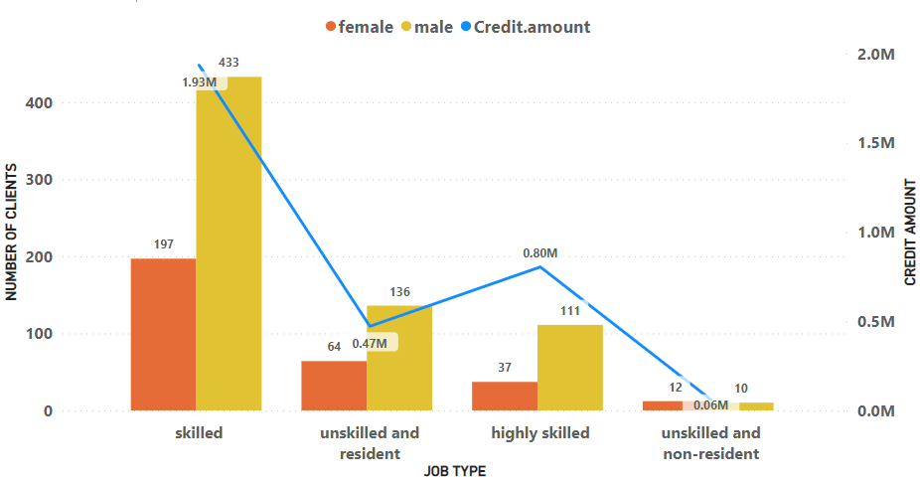
CREDIT TAKEN BY THE DIFFERENT JOB HOLDERS
Our portfolio is stable because most of the credit amount is given to Skilled or Highly Skilled individuals.
So till now we can say if the person has good past credit rating, and if the individual is male and aged between 18-50 along with job with good skill, he must be prioritized.

Slide 9
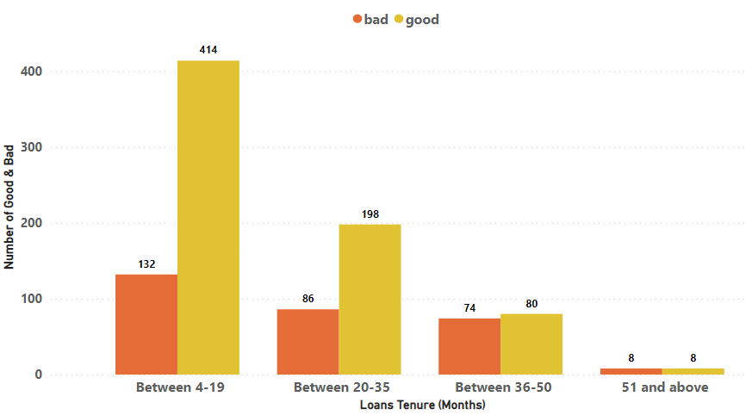
DURATION OF REPAYMENT ALONG WITH GOOD/BAD
Most of the loans taken by the consumer are for less than equal to 3 years but the long term loans are more cautious because they have almost same ratio of GOOD & BAD.

Slide 10
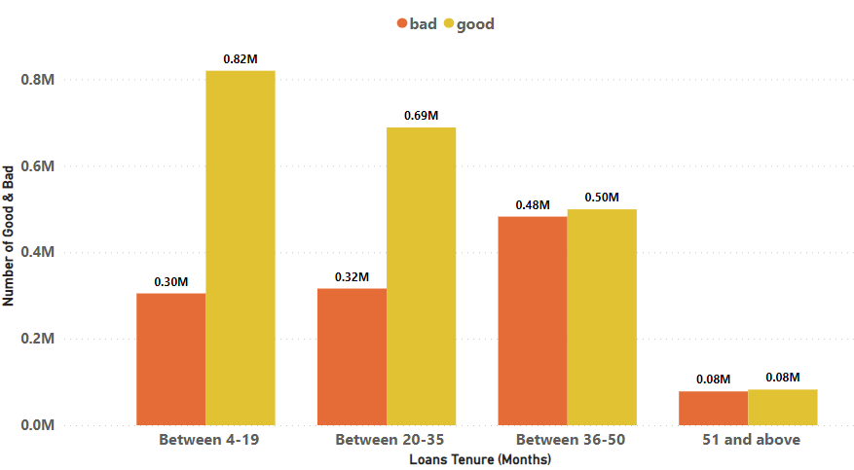
LOAN AMOUNT ON THE BASIS OF DURATION
Total Portfolio is of 3.27M and out of which 2.13M is taken for short term requirements that is less than equal to 3 years

Slide 11
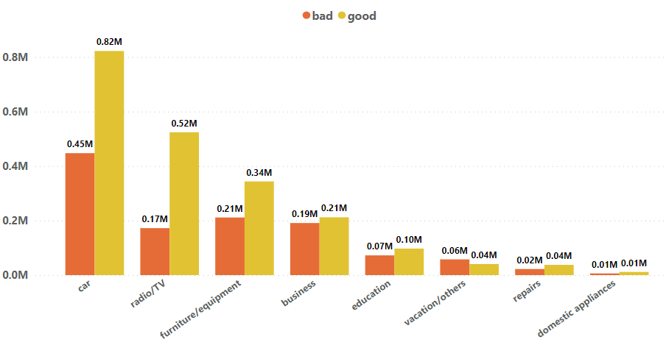
PURPOSE OF LOAN ALONG WITH AMOUNT
Most of the loans are taken for Car financing, radio TV & Furniture/equipment.

Slide 12
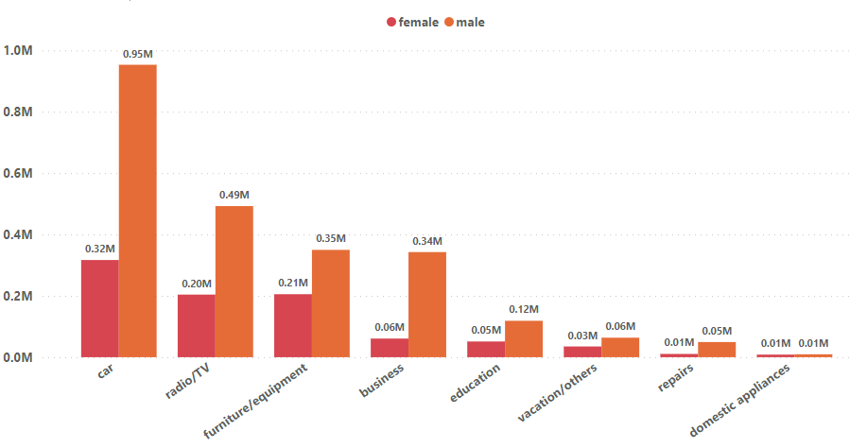
GENDER AND PURPOSE OF LOAN

Slide 13
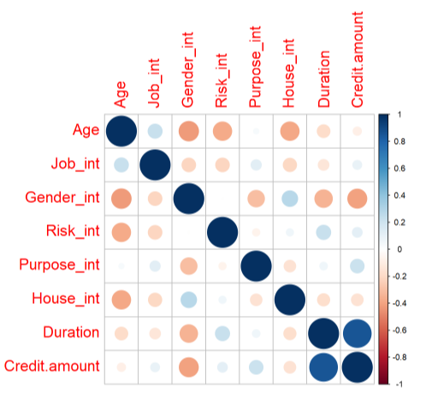
FINDING THE CORRELATION
Credit Amount and Duration are highly correlated as the duration increases the amount borrowed by individual are greater, where as Risk vs Age has negative correlation which shows greater the age lesser the Risk.

Slide 14
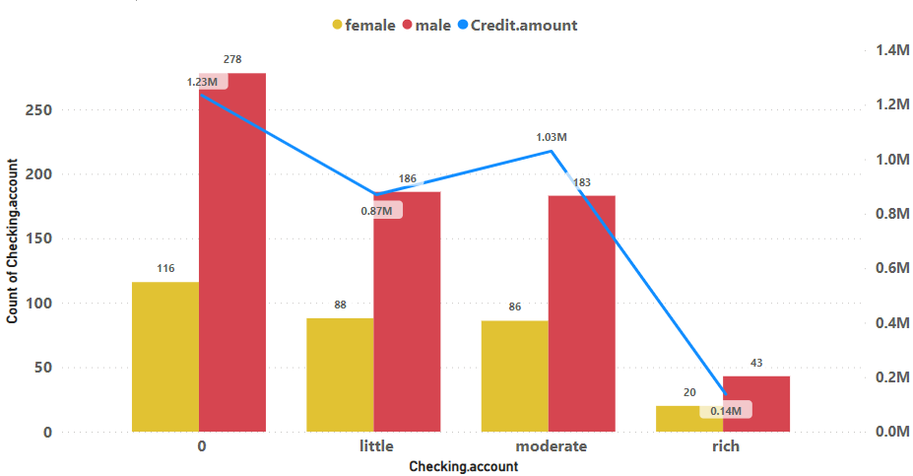
CHECKING ACCOUNT HOLDERS EXPOSURE TO CREDITS
Checking accounts are used by business owners and mostly business are owned by males hence our portfolio is stable because most of the good rated customers are males.

Slide 15
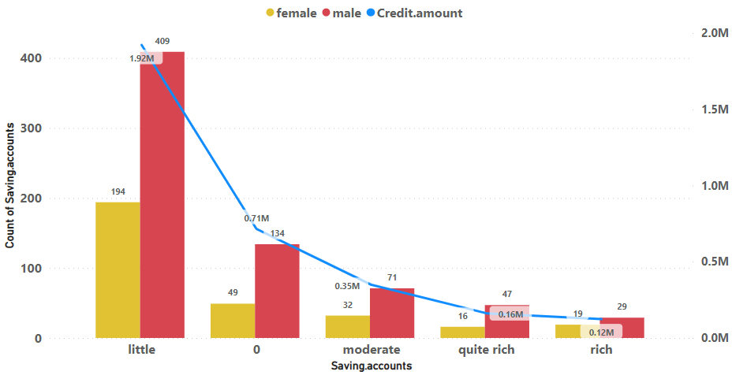
SAVING ACCOUNT HOLDERS EXPOSURE TO CREDITS
Most of the saving accounts with little savings were owned by male customers and most of the male customers have applied for financing are male hence we can say that male customers with saving accounts can be prioritized in future.

Slide 16
THANKS FOR YOUR ATTENTION

